Slide 1

Objects
Made by: Ayman naeem

Slide 2
Objects
Objects are entities with properties and methods and resemble to real life objects.
Properties specify the characteristics or attributes of an object, while methods identify the behavior of an object.
For example, consider a real life object namely, Car.
The attributes of the Car object can include name, weight, color and model.
The methods of the car could be start(), stop(), drive() and brake() that specifies the running behavior of the car.

Slide 3
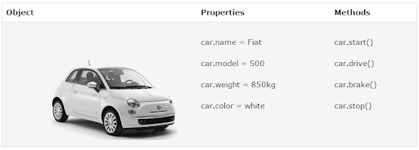
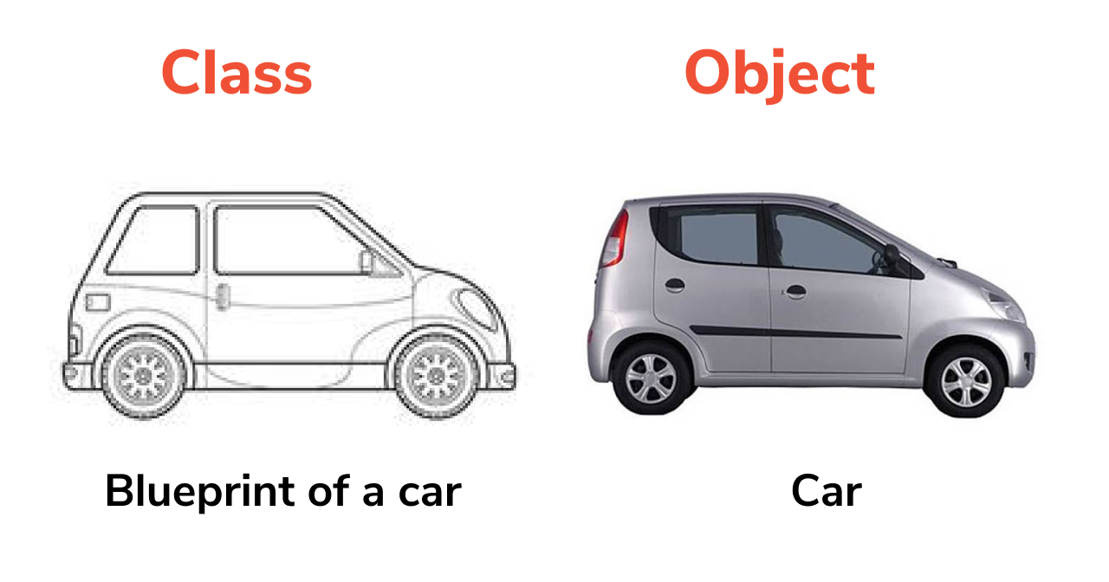
Cont…

Slide 4
Cont…
JavaScript provides built-in objects and allows creating user-defined objects. the description of the object is as follows:
Built-in Objects - Are pre-defined objects which are already defined. Their properties and methods need to be called to fulfill a task. An example of a pre-defined object is the Array object.
Custom Objects - Are user-defined objects, which the developer explicitly creates in the script and defines their properties and methods. For example, to store the doctor details, such as name, age, hospital name, and so on, an object named doctor can be created.

Slide 5
Methods to creating custom objects
1.Using Literal Method
var person={
firstname:"Haris",
Lastname:"Rehman",
age:20
}
person.firstname);

Slide 6
2.Using Direct Method
Syntax:
var object_name = new Object();
where,
object_name: Is the name of the object.
new: Is the keyword that allocates memory to the custom object. This is known as instantiation of an object.
Object: Is the built-in JavaScript object that allows creating custom objects.
Example
var person=new Object();
person.firstName = "Ayman";
person.lastName = "Naeem";
console.log(person.firstName);
The above method is bit longer to type. What if we had to create hundreds of person Objects. The problem we have to manually add properties of the object.

Slide 7
3.Template Method
An object’s template refers to a structure that specifies the custom properties and methods of an object.
There are two steps in creating an object by using this method. First, the object type is declared using a constructor function. Second, you specify the object of the declared object type by using the new keyword.
JavaScript allows creating a reusable template without having to redefine properties and methods repeatedly to fulfill a particular object’s requirements. This template is known as the constructor function.
The syntax to create a constructor function is as follows:
Syntax:
function object_type(list of parameters)
{
// Body specifying properties and methods
}
where,
object_type: Indicates the object type.
list of parameters: Is optional and specifies the parameters to be passed to a function separated by commas.

Slide 8
Cont…
Syntax:
object_name = new object_type(optional list of arguments);
where,
object_name: Is the name of the object.
//constructor function
function Person(){
this.name="John",
this.age=23
}
//create objects
var person=new Person();
//access properties
console.log(person.name);

Slide 9
This keyword
This keyword is used in constructor function, this refers to the object when the object is created. hence, when an object access the properties, it can directly access the property as person1.name.

Slide 10
Constructor function parameters
function Employee_info(name, age, experience)
{
this.name = name;
this.age= age;
this.experience= experience;
}
// Creates an object using new keyword
empMary = new Employee_info('Mary', '34', '5 years');
alert ("Name: "+ empMary.name + "\n" +"Age: "+empMary.age+
"\n"+"Experience: "+empMary.experience);

Slide 11
Constructor function vs. object literal
function Employee_info(name, age, experience)
{
this.name = name;
this.age= age;
this.experience= experience;
}
// Creates an object using new keyword
var empMary1 = new Employee_info('Mary', '34', '5 years');
var empMary2 = new Employee_info('John','20','Fresh')
alert ("Name: "+ empMary1.name + "\n" +"Age: "+empMary1.age+ "\n"+"Experience: "+empMary1.experience);
alert ("Name: "+ empMary2.name + "\n" +"Age: "+empMary2.age+ "\n"+"Experience: "+empMary2.experience);

Slide 12
Cont…
var person=new Object();
person.firstName = "Ayman";
person.lastName = "Naeem";
console.log(person.firstName);
var student=person;
student.name="John";
console.log(person.name);

Slide 13
Creating Methods for Custom Objects
//constructor function
function Employee_info(name, age, experience)
{
this.name = name;
this.age= age;
this.experience= experience;
//method
this.greet=function(){
return('Hi '+this.name);
}
}
// Creates an object using new keyword
var empMary1 = new Employee_info('Mary', '34', '5 years');
var empMary2 = new Employee_info('John','20','Fresh')
alert ("Name: "+ empMary1.name + "\n" +"Age: "+empMary1.age+ "\n"+"Experience: "+empMary1.experience);
alert ("Name: "+ empMary2.name + "\n" +"Age: "+empMary2.age+ "\n"+"Experience: "+empMary2.experience);
//calling method
var greeting=person1.greet();
alert(greeting);

Slide 14
Built-in objects
The object model of JavaScript language forms the foundation of the language. These objects help to provide custom functionalities in the script.
JavaScript treats the primitive data types as objects and provide equivalent object for each of them.
For example, if a variable contains a string of characters, then it is treated as String object by JavaScript.
JavaScript objects are categorized as built-in objects, browser objects, and HTML objects.

Slide 15
math object
Math is a built-in object that has properties and methods for mathematical constants and functions. it’s not a function object.
Unlike many other global objects, math is not a constructor. all properties and methods of math are static.
you refer to the constant pi as Math.PI and you call the sine function as Math.sin(x) where x is the method’s argument. constants are defined with the full precision of real numbers in JavaScript.

Slide 16
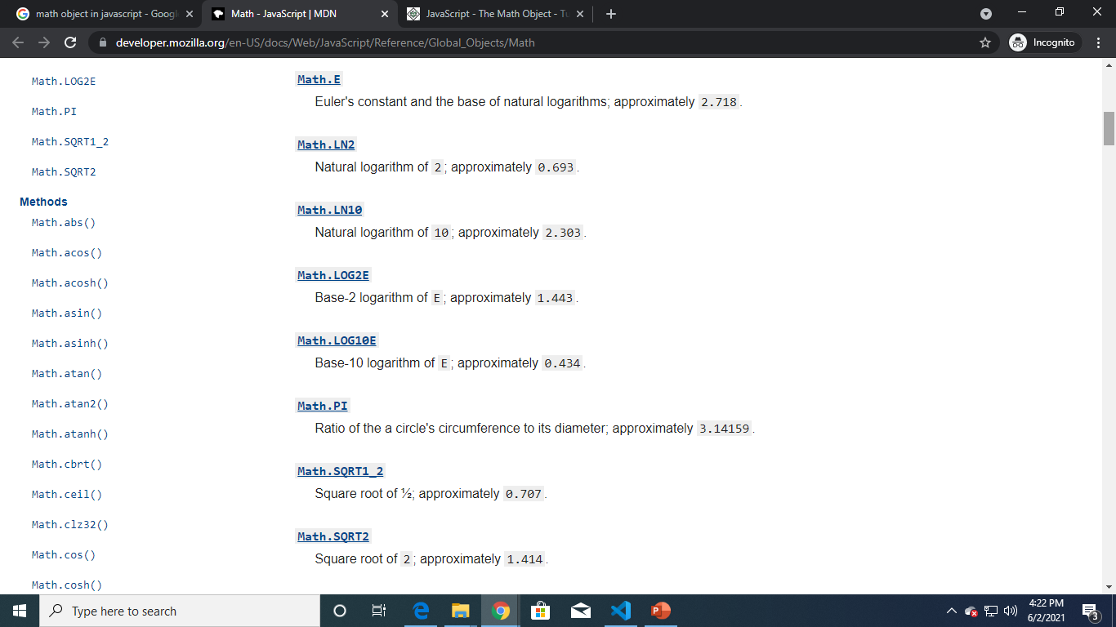
PROPERTIES

Slide 17
EXAMPLE 1
var property_value = Math.PI;
document.write("Property Value is : " + property_value);
//Property Value is : 3.141592653589793
EXAMPLE 2
var property_value = Math.SQRT1_2;
document.write("Property Value is : " + property_value);
//Property Value is : 0.7071067811865476
EXAMPLE 3
var property_value = Math.SQRT2;
document.write("Property Value is : " + property_value);
//Property Value is : 1.4142135623730951

Slide 18
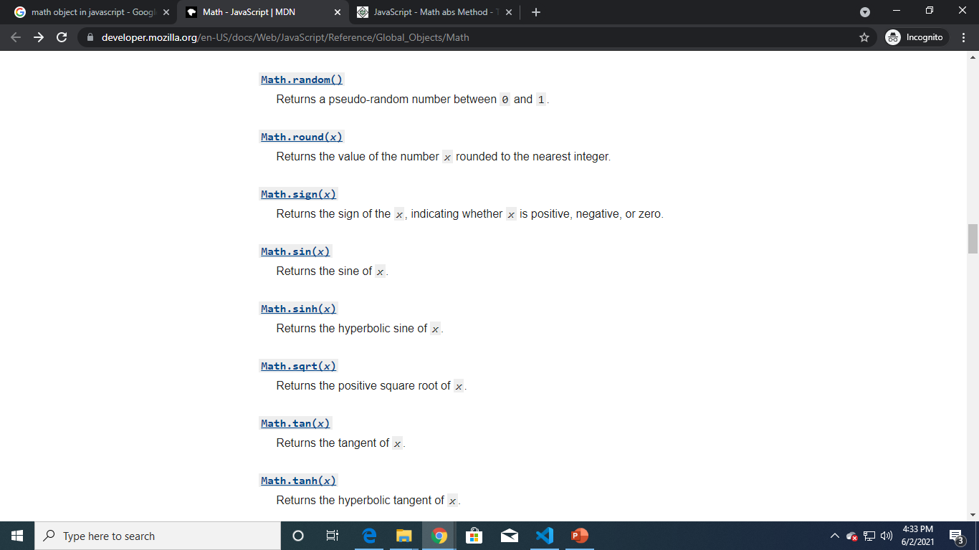
SOME METHODS

Slide 19
EXAMPLE 1
var value = Math.floor(10.7);
document.write("Test Value : " + value );
//Test Value : 10
EXAMPLE 2
var value = Math.pow(7, 2);
document.write("Test Value : " + value ); //Test Value : 49
EXAMPLE 3
var value = Math.sin( 0.5 );
document.write("Test Value : " + value ); //Test Value : 0.479425538604203

Slide 20
math object
The string object lets you work with a series of characters; it wraps JavaScript's string primitive data type with a number of helper methods.
As JavaScript automatically converts between string primitives and string objects, you can call any of the helper methods of the string object on a string primitive.
you refer to the constant pi as Math.PI and you call the sine function as Math.sin(x) where x is the method’s argument. constants are defined with the full precision of real numbers in JavaScript.

Slide 21
date object
The date object allows you to define and manipulate the date and time values programmatically.
The Date object calculates dates in milliseconds from 01 January, 1970. The date and time can be specified by creating an instance of the Date object.
var today=new Date();
var date=today.getDate();
var month=today.getMonth();
var year=today.getFullYear();
alert(date+'/'+month+'/'+year);

Slide 22
String object
Strings in JavaScript are a set of characters that are surrounded by single or double quotes. These characters can include alphabets, numbers, spaces, and symbols: %, @, &, and so on.
The built-in String object allows you to perform different text operations on them. Some of the examples of these operations include: searching for a specific character occurrence, retrieving a substring, merging two set of characters, and so on.
The String object is instantiated with the new keyword, which invokes the predefined constructor function of the String object.

Slide 23
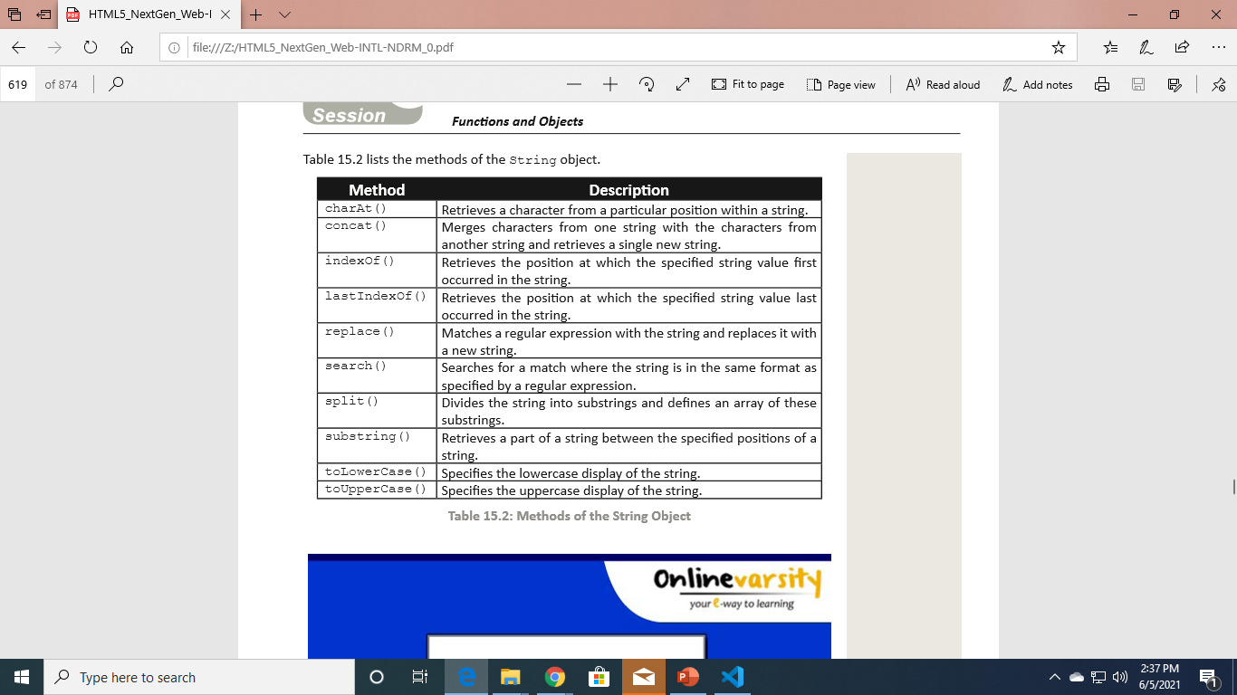
EXAMPLE
var full_name=new String('David James Taylor');
document.write('Number of Characters are: ' +full_name.length+ '<BR/>');
document.write("Character at Position 6 is: " +full_name.charAt(6)+ '<BR/>');

Slide 24
with Statement
The with statement allows to remove the object reference for each JavaScript statement. This is done by referring to the common object only once for a set of statements.
The with statement starts with the with keyword followed by the open and close brackets, which holds the statements that refer to a common object.
This increases the readability of the code and also reduces time required in writing each object reference in every related statement.

Slide 25
syntax
with(object_name) { //statements }
Where,
Object_name: is the name of a common object for the set of statements

Slide 26
Example
var person=new Object();
person.firstName = "Ayman";
person.lastName = "Naeem";
with(person)
{
document.write(firstName);
}

